Slide 1
Supervised ML - Classification Credit Card Default Prediction

Slide 2
Problem Statement
This project is aimed at predicting the case of customers default payments in Taiwan. From the perspective of risk management, the result of predictive accuracy of the estimated probability of default will be more valuable than the binary result of classification - credible or not credible clients.

Slide 3
Data Description
The data contains 30000 rows and 25 columns.
Attribute Information:
This research employed a binary variable, default payment (Yes = 1, No = 0), as the response variable. This study reviewed the literature and used the following 23 variables as explanatory variables:
X1: Amount of the given credit (NT dollar): it includes both the individual consumer credit and his/her family (supplementary) credit.
X2: Gender (1 = male; 2 = female).
X3: Education (1 = graduate school; 2 = university; 3 = high school; 4 = others).
X4: Marital status (1 = married; 2 = single; 3 = others).

Slide 4
X5: Age (year).
X6 - X11: History of past payment. We tracked the past monthly payment records (from April to September, 2005) as follows: X6 = the repayment status in September, 2005; X7 = the repayment status in August, 2005; . . .;X11 = the repayment status in April, 2005. The measurement scale for the repayment status is: -1 = pay duly; 1 = payment delay for one month; 2 = payment delay for two months; . . .; 8 = payment delay for eight months; 9 = payment delay for nine months and above.
X12-X17: Amount of bill statement (NT dollar). X12 = amount of bill statement in September, 2005; X13 = amount of bill statement in August, 2005; . . .; X17 = amount of bill statement in April, 2005.
X18-X23: Amount of previous payment (NT dollar). X18 = amount paid in September, 2005; X19 = amount paid in August, 2005; . . .;X23 = amount paid in April, 2005.

Slide 5
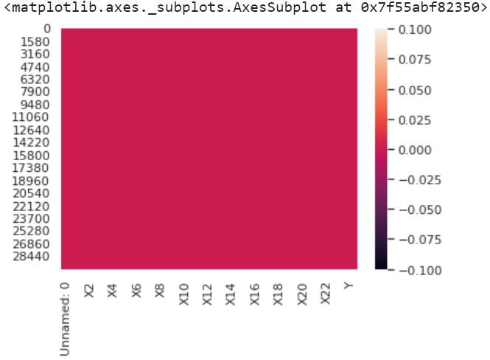
Checking for null value
The data doesn’t have any null values .
For showing this we have plotted heat map:

Slide 6
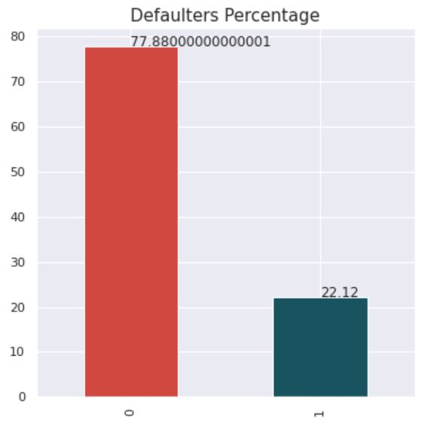
Plotted Bar graph for showing Defaulter percentage
So as we can see from graph that the given data have total 78% for non defaulter where as 22% defaulter.

Slide 7
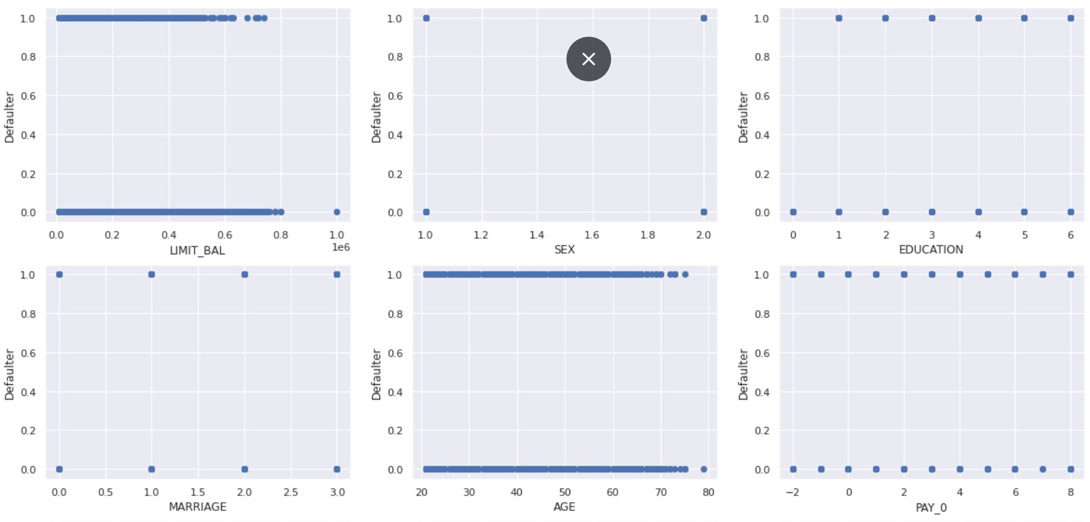
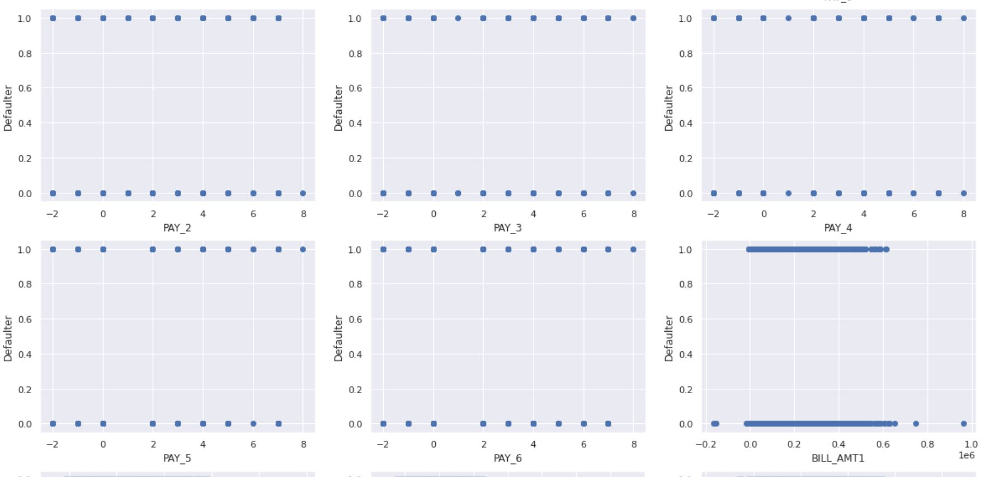
Plotting scatterplot between target and some of feature .

Slide 8
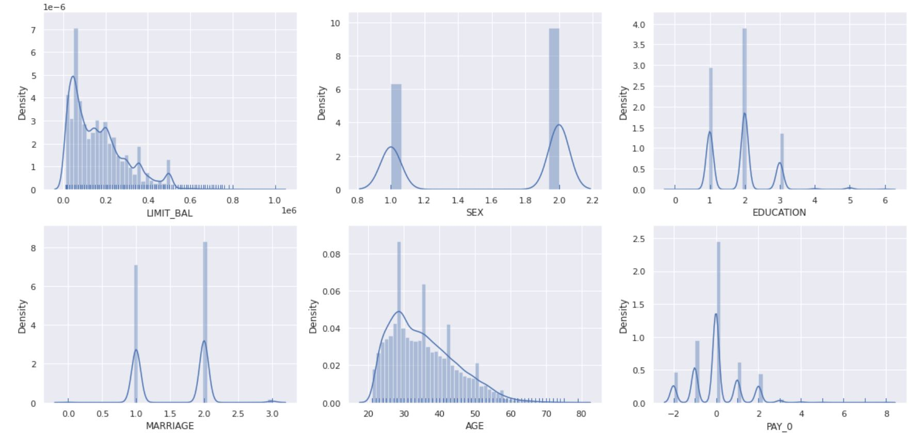
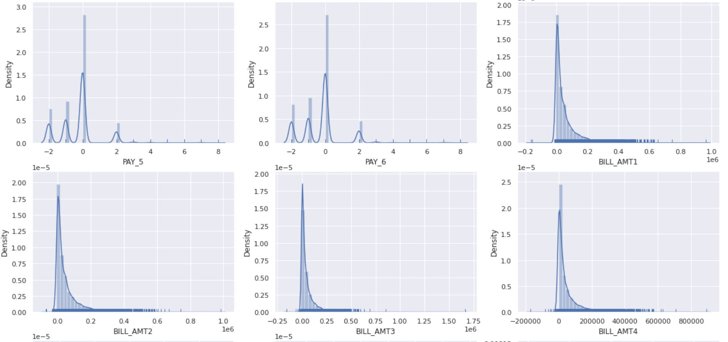
Plotting distplot
From above plotted graph we can see that some of feature are positively skewed such as LIMIT_BAL , BILL_AMT and more .

Slide 9
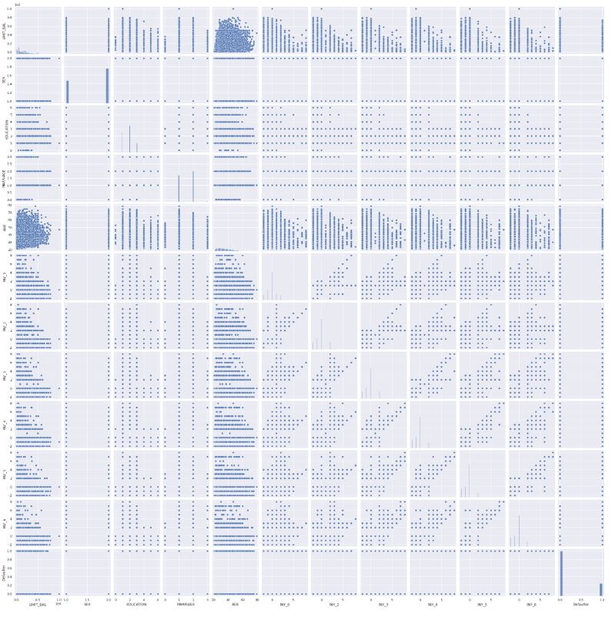
Pair Plot for checking multicollinerity
From plotted pairplot graph with some feature we can see that some of them are highly multicollinear with other feature .

Slide 10

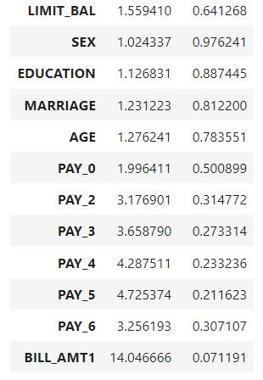
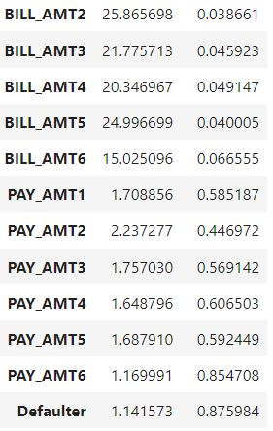
calculating variance inflation factor (VIF) and Tolerance for checking multicollinearity
For any feature vif value should be less then 10 if its greater then 10 i.e.; its highly multicollinear with other feature .
As from above chart we can see that some of features in data are Multicollinear such as BILL_AMT1 , BILL_AMT2 , BILL_AMT3 , BILL_AMT4 , BILL_AMT5 , BILL_AMT6

Slide 11
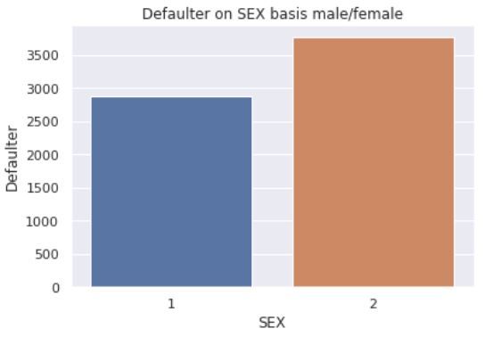
Checking which sex is most in defaulter list
1 = male; 2 = female From graph its clear that female are more in defaulter list then male. Out of 18112 female , 3763 are in defaulter list and out of 11888 male ,2873 are in defaulter list.

Slide 12
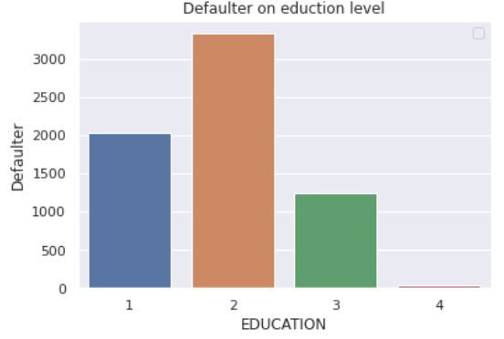
Checking education level of defaulter
1 = graduate school; 2 = university; 3 = high school; 4 = others From graph its clear that University students are most defaulter . Out of 14030 University student , 3330 are in defaulter list . Out of 10585 Graduate student , 2036 are in defaulter list . And out of 4917 high school student , 1237 are in defaulter list.

Slide 13
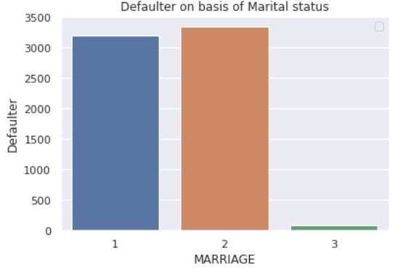
Checking defaulter on basis of marital status
1 = married; 2 = single; 3 = others . We can see from above graph that unmarried person are most in defaulter list . out of 15964 single person , 3341 are on defaulter list . out of 13659 married person , 3206 are in defaulter list

Slide 14
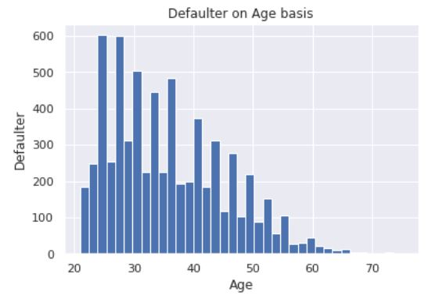
Checking defaulter on basis of their ages
From above graph we can conclude that maximum of defaulters are from age 25-30 years and some are from 30-40 years . We can also assume that young people are more often to be a defaulter. As they can be unemployed or can have low income and they spend more money .

Slide 15
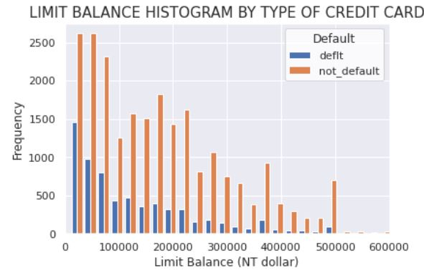
Checking LIMIT BALANCE HISTOGRAM BY TYPE OF CREDIT CARD
From beside graph we can say that whose balance limit is up to 100000 are more defaulter . While whose limit is up to 20000-500000 are lesser in defaulter list.

Slide 16
Different types of Data
1 . The given data as it is .
2 . Standardized data by using SandardScaler from skearn
Standardizing a dataset involves rescaling the distribution of values so that the mean of observed values is 0 and the standard deviation is 1.
Normalizing Data by using MinMaxScaler
Normalization is a rescaling of the data from the original range so that all values are within the new range of 0 and 1.

Slide 17
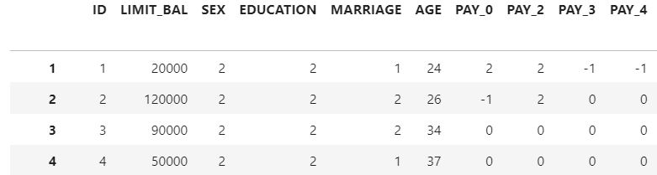
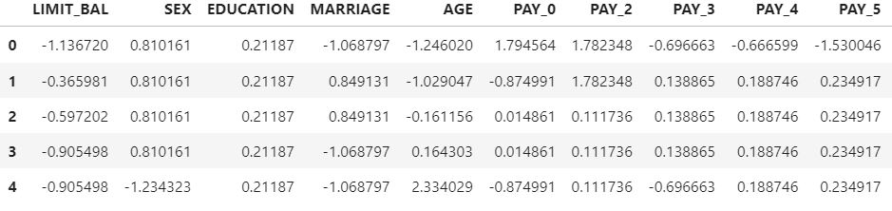
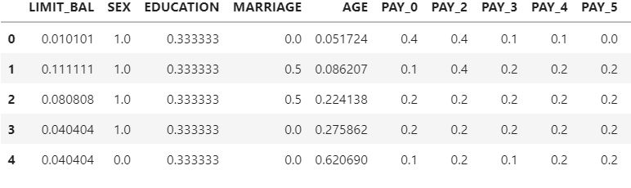
Sample of all types of data
The Given Data
Standardized Data
Normalised Data

Slide 18
Machine Learning
Machine learning (ML) is a type of artificial intelligence (AI) that allows software applications to become more accurate at predicting outcomes without being explicitly programmed to do so. Machine learning algorithms use historical data as input to predict new output values.
Classification is a process of categorizing a given set of data into classes, It can be performed on both structured or unstructured data. The process starts with predicting the class of given data points. The classes are often referred to as target, label or categories.

Slide 19
Confusion Matrix
A Confusion matrix is an N x N matrix used for evaluating the performance of a classification model, where N is the number of target classes. The matrix compares the actual target values with those predicted by the machine learning model. This gives us a holistic view of how well our classification model is performing and what kinds of errors it is making.
True Positive
It means the actual value and also the predicted values are the same.
In our case the actual value is also NON_DEFAULT and the model prediction is also NON_DEFAULT.
If you observe for the TP cell the positive value is the same for Actual and predicted.

Slide 20
False Negative:
This means the actual value is positive in our case it is NON_DEFAULT but the model has predicted it as negative i.e., DEFAULT. So the model has given the wrong prediction, It was supposed to give a positive(NON_DEFAULT) but it has given a negative(DEFAULT) so whatever the negative output we got is false, hence the name False Negative.
False Positive
This means the actual value is negative in our case it is DEFAULT but the model has predicted it as positive i.e., NON_DEFAULT. So the model has given the wrong prediction, it was supposed to give negative(DEFAULT) but it has given positive(NON_DEFAULT) so whatever the positive output we got is false, hence the name False Positive.
True Negative:
It means the actual value and also the predicted values are the same. In our case, the actual values are also DEFAULT and the Prediction is also DEFAULT

Slide 21
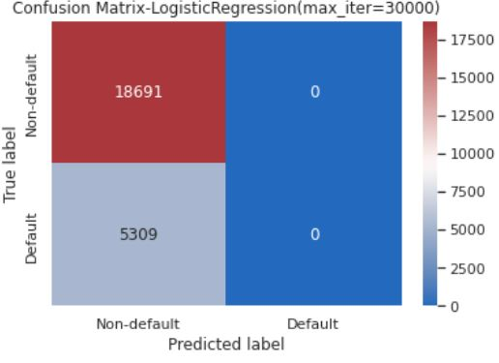
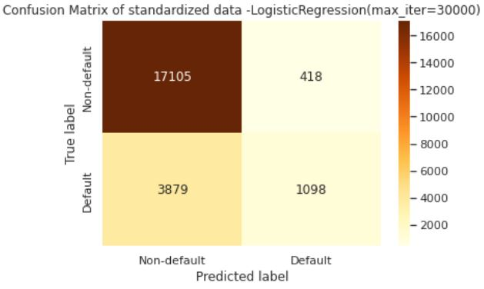
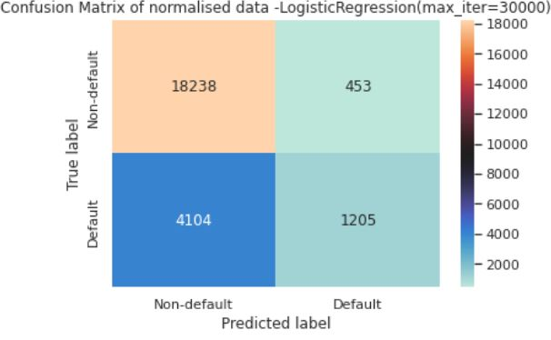
Comparing Confusion Matrixes for Logistic Regression

Slide 22
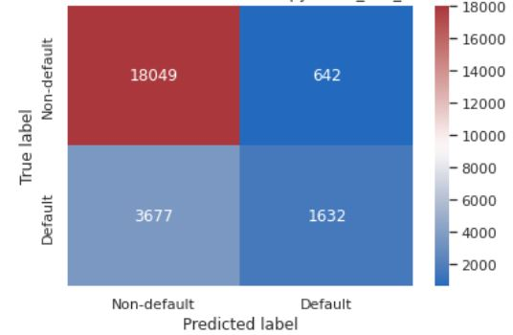
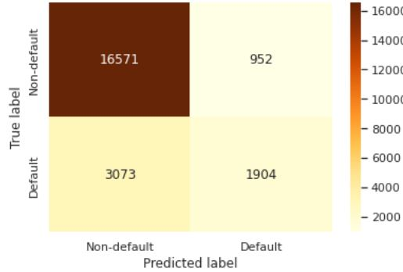
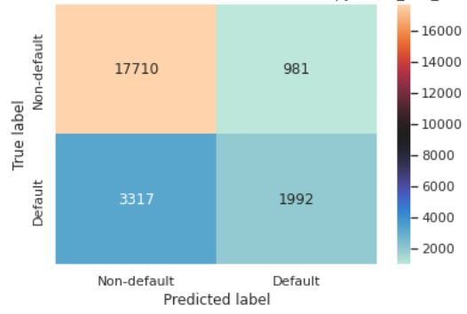
Comparing Confusion Matrixes of DecisionTreeClassifier

Slide 23
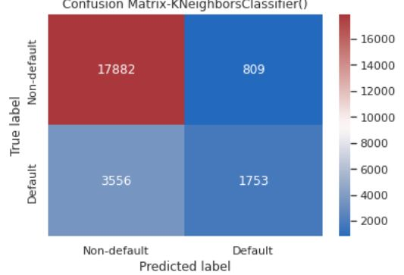
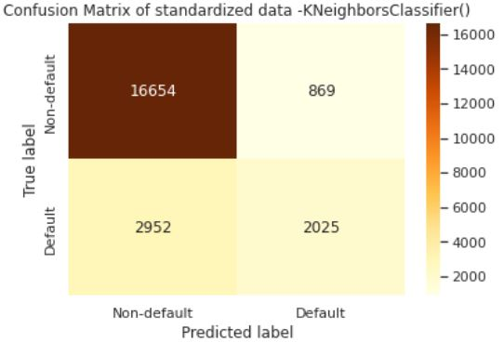
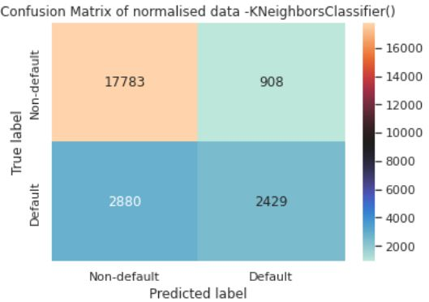
Comparing Confusion Matrixes Of KNeighborsClassifier

Slide 24
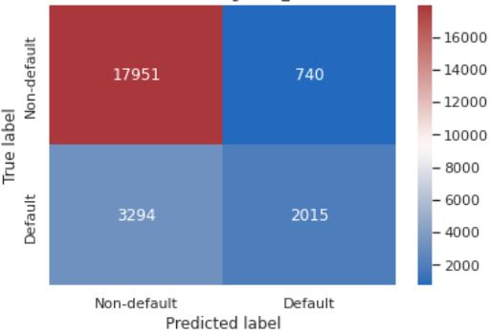
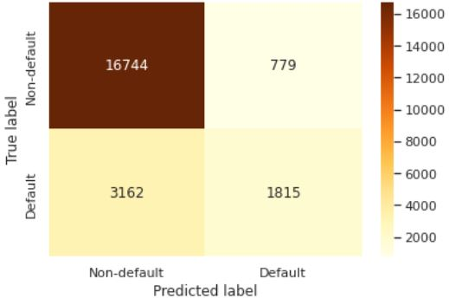
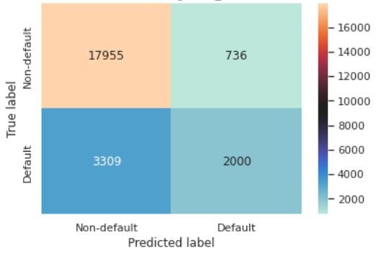
Comparing Confusion Matrixes of RandomForestClassifier

Slide 25
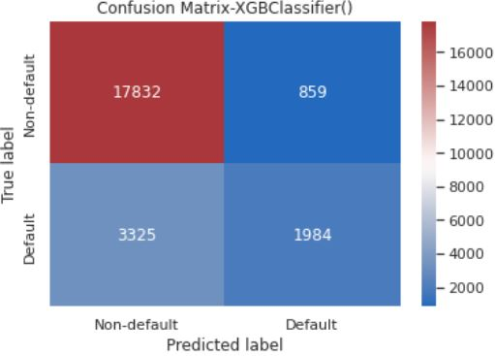
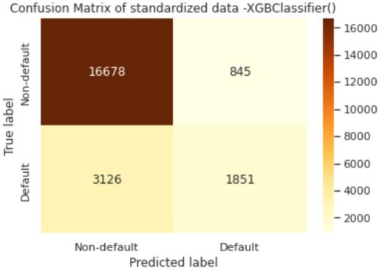
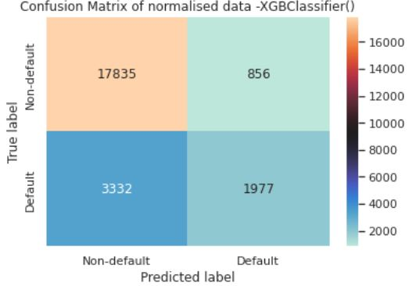
Comparing Confusion Matrixes of XGBClassifier

Slide 26
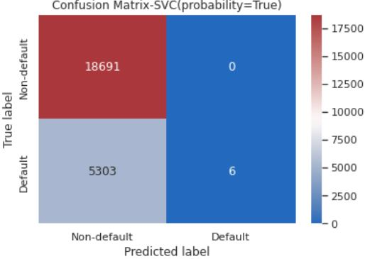
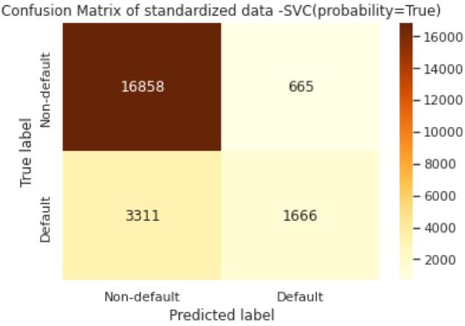
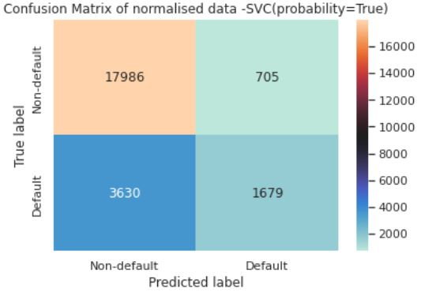
Comparing Confusion Matrixes Of SupportVectorClassifier

Slide 27
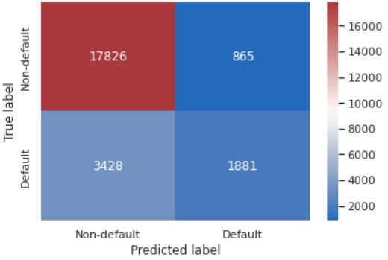

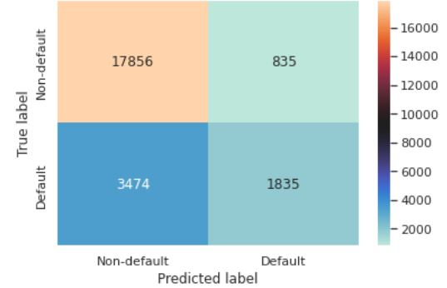
Comparing Confusion Matrixes Of AdaBoostClassifier

Slide 28
Auc Roc Curve
The Receiver Operator Characteristic (ROC) curve is an evaluation metric for binary classification problems. It is a probability curve that plots the TPR against FPR at various threshold values and essentially separates the ‘signal’ from the ‘noise’. The Area Under the Curve (AUC) is the measure of the ability of a classifier to distinguish between classes and is used as a summary of the ROC curve.
The higher the AUC, the better the performance of the model at distinguishing between the positive and negative classes.
When AUC = 1, then the classifier is able to perfectly distinguish between all the Positive and the Negative class points correctly. If, however, the AUC had been 0, then the classifier would be predicting all Negatives as Positives, and all Positives as Negatives.

Slide 29
When 0.5<AUC<1, there is a high chance that the classifier will be able to distinguish the positive class values from the negative class values. This is so because the classifier is able to detect more numbers of True positives and True negatives than False negatives and False positives.
When AUC=0.5, then the classifier is not able to distinguish between Positive and Negative class points. Meaning either the classifier is predicting random class or constant class for all the data points.
So, the higher the AUC value for a classifier, the better its ability to distinguish between positive and negative classes.

Slide 30
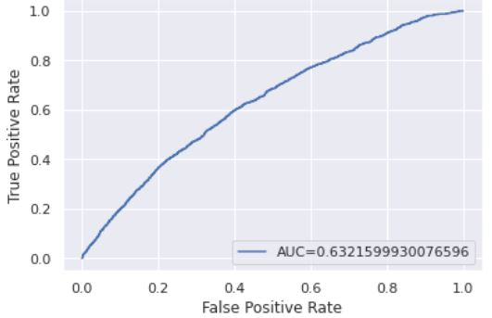
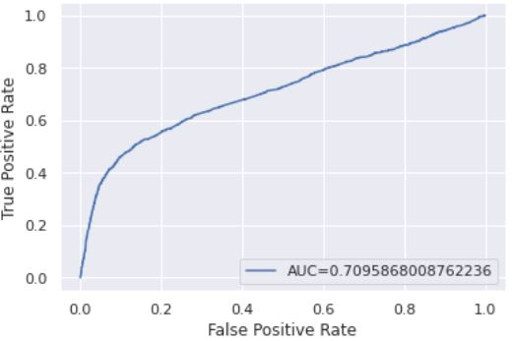
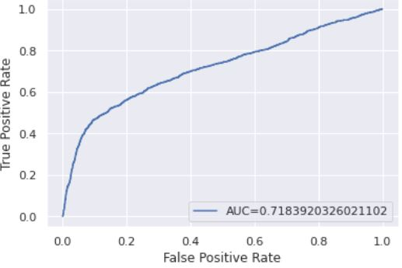
Comparing AucRocCurve of LogisticRegression
Given Data
Standardized Data
Normalized Data

Slide 31
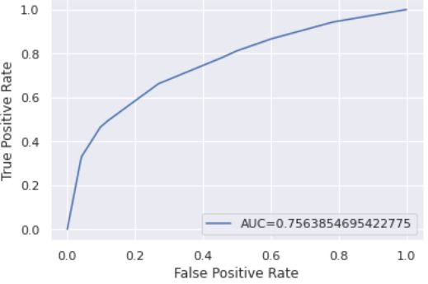
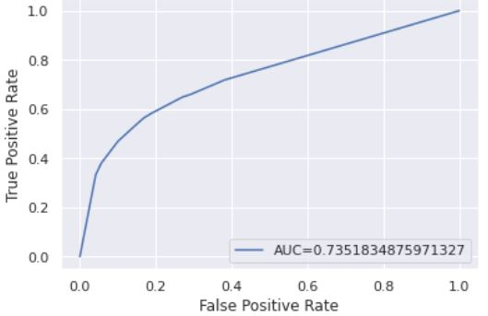
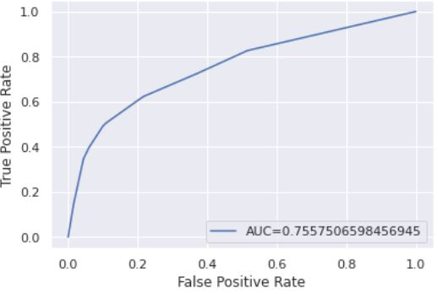
Comparing AucRocCurve of DecisionTreeClassifier
Given Data
Standardized Data
Normalized Data

Slide 32
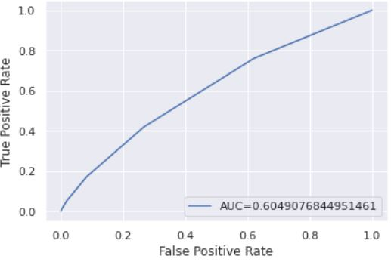
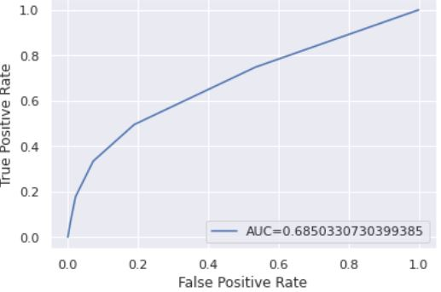
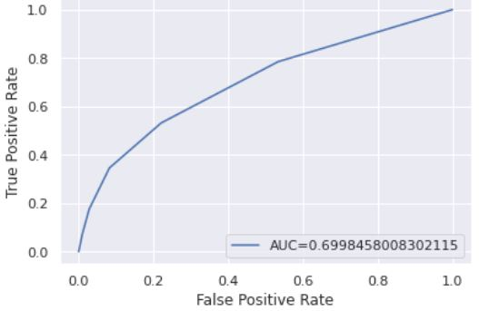
Comparing AucRocCurve of KNeighborsClassifier
Given Data
Standardized Data
Normalized Data

Slide 33

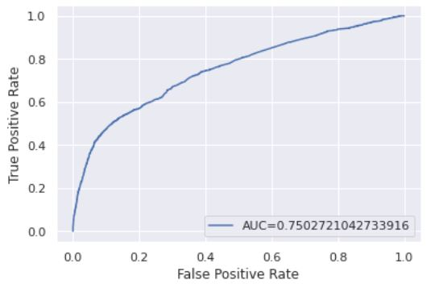
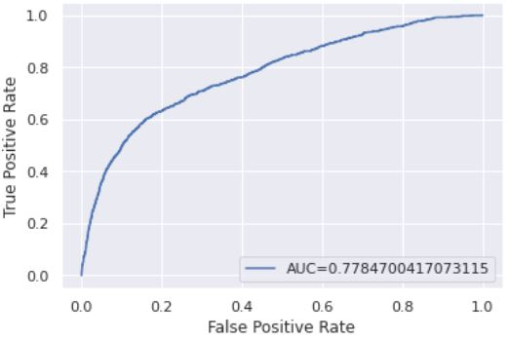
Comparing AucRocCurve of RnadomForestClassifier
Given Data
Standardized Data
Normalized Data

Slide 34



Comparing AucRocCurve of XGBClassifier
Given Data
Standardized Data
Normalized Data

Slide 35
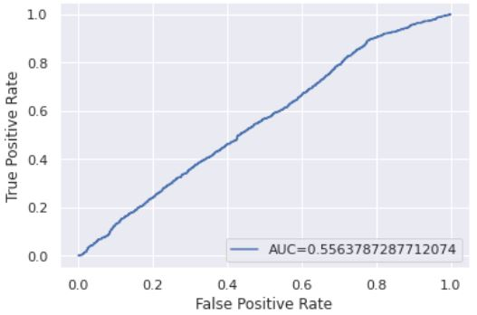
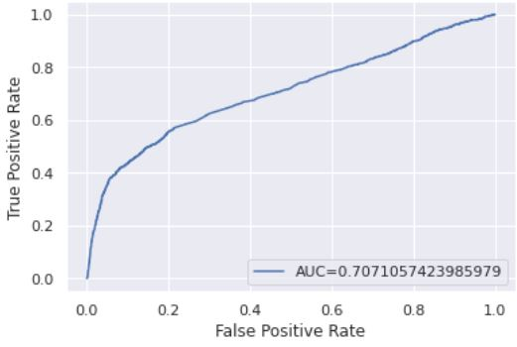

Comparing AucRocCurve of SupportVectorClassifier
Given Data
Standardized Data
Normalized Data

Slide 36



Comparing AucRocCurve of AdaBoostClassifier
Given Data
Standardized Data
Normalized Data

Slide 37
Conclusion
We have predicted the Credit Card Default using different methods in this project.We have used simple machine learnings such as logistic regression, Decision Tree Classifier and tried to plot the Decision tree flow chart , K Neighbors Classifier, XGBClassifier , Support Vector Classifier ,AdaBoostClassifier, Random Forest Classifier and KNeighborsClassifier techniques.
We also tried to train our model in normalized and standardized data to compare at which data does machine learning performs good .
Out of these we found that at normalized data machine learning is performing good in which AdaBoostClassifier , SVN , XGBClassifier , RandomForestClassifier , DecisionTreeClassifier and LogisticRegression ,these are working great with AUC value more then 0.70 .

